Slide 1

Google Play Store Apps Analysis
COURSE : Data Science
Presenter: Shiji Shajahan

Slide 2
Google Play Store Apps Analysis
Introduction
The Google Play Store (originally the Android Market), operated and developed by Google, serves as the official app store for the Android, allowing users to download apps
Mobile app distribution platform
Google Play store also serves as a digital media store, offering music, books, movies, and television programs
Problem Statement
The Play Store apps data has enormous potential to drive app-making businesses to success.
Actionable insights can be drawn for developers to work on and capture the Android market.
The purpose of this Analysis is to gather and analyse detailed information on apps in the Google Play Store in order to provide insights on app features.
Methodology
Choose the Dataset, Read and Examine the dataset
Data Cleaning and Data Manipulation using Pandas and Numpy
Analysis relation between columns
Visualization of graphs using Matplotlib, Seaborn and Plotly
Evaluations, Findings and Summary

Slide 3
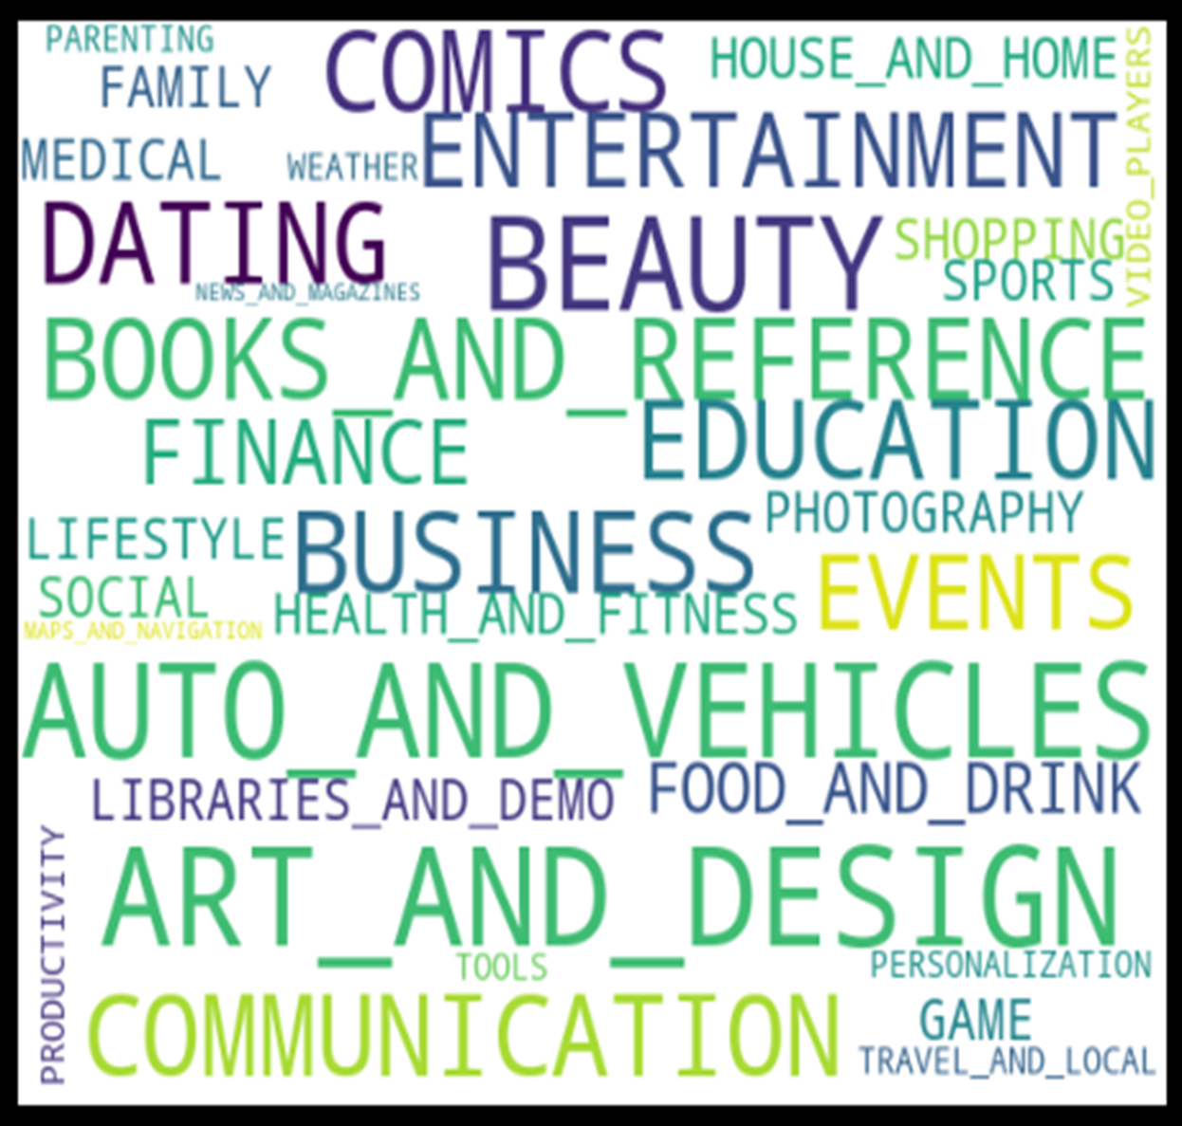
DATA SET
App: Application name
Category: Category the app belongs to
Rating: Overall user rating of the app
Reviews: Number of user reviews for the app
Size: Size of the app
Installs: Number of user downloads/installs for the app
Type: Paid or Free
Price: Price of the app
Content Rating: Age group the app is targeted at - Children / Mature 21+ / Adult
Genres: An app can belong to multiple genres (apart from its main category)
Last Updated: Date when the app was last updated on Play Store
Current Ver:Current version of the app available on Play Store
Android Ver: Min required Android version

Slide 4
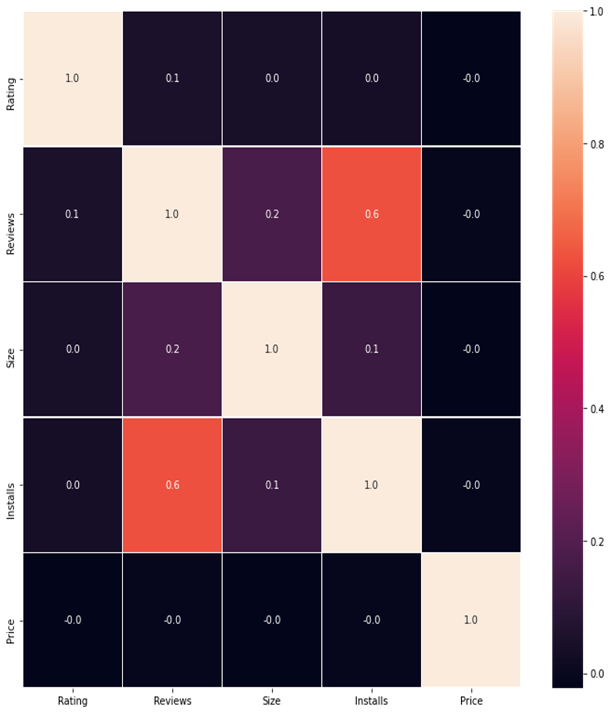
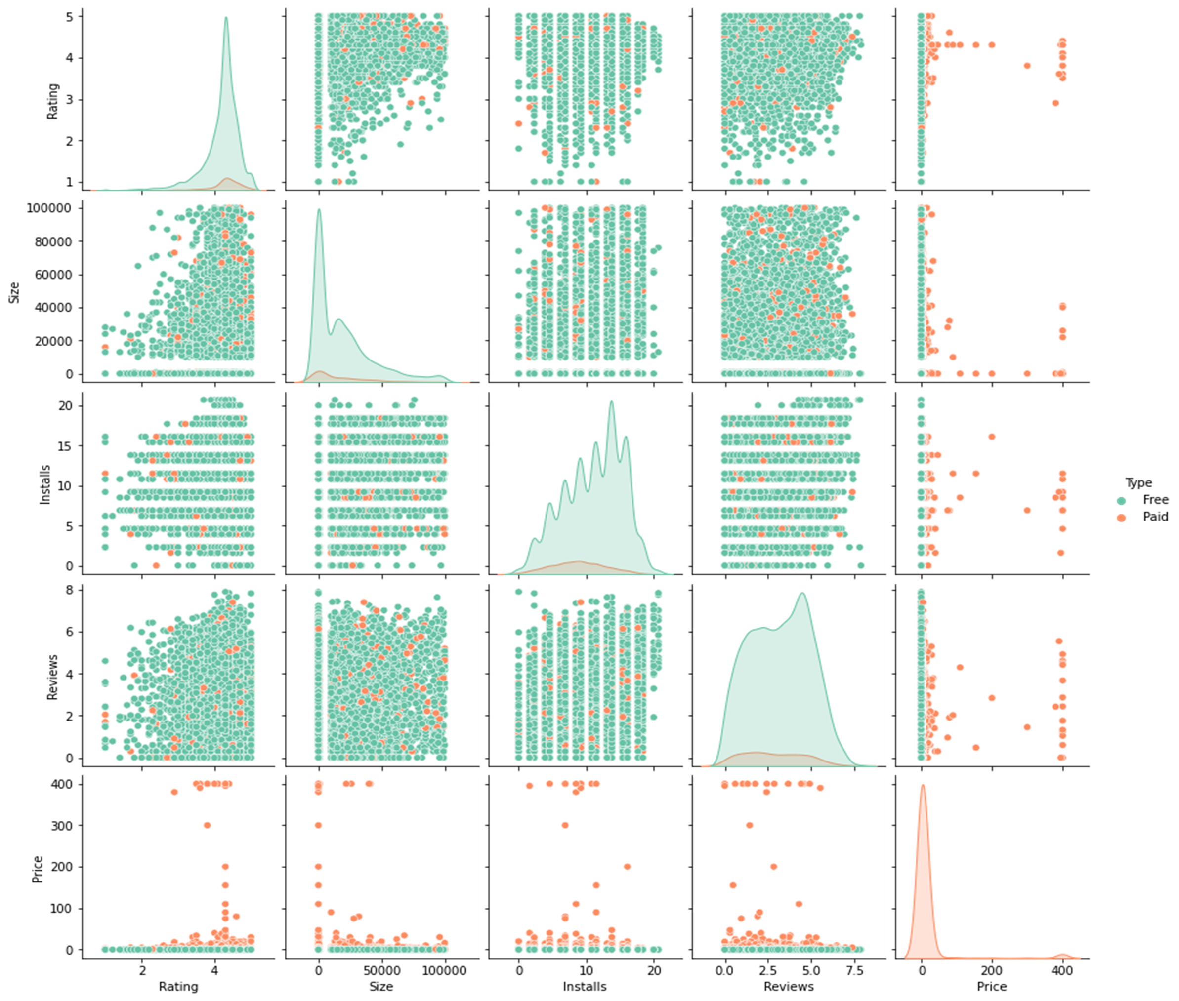
Result and Discussions
Correlation Map

Slide 5
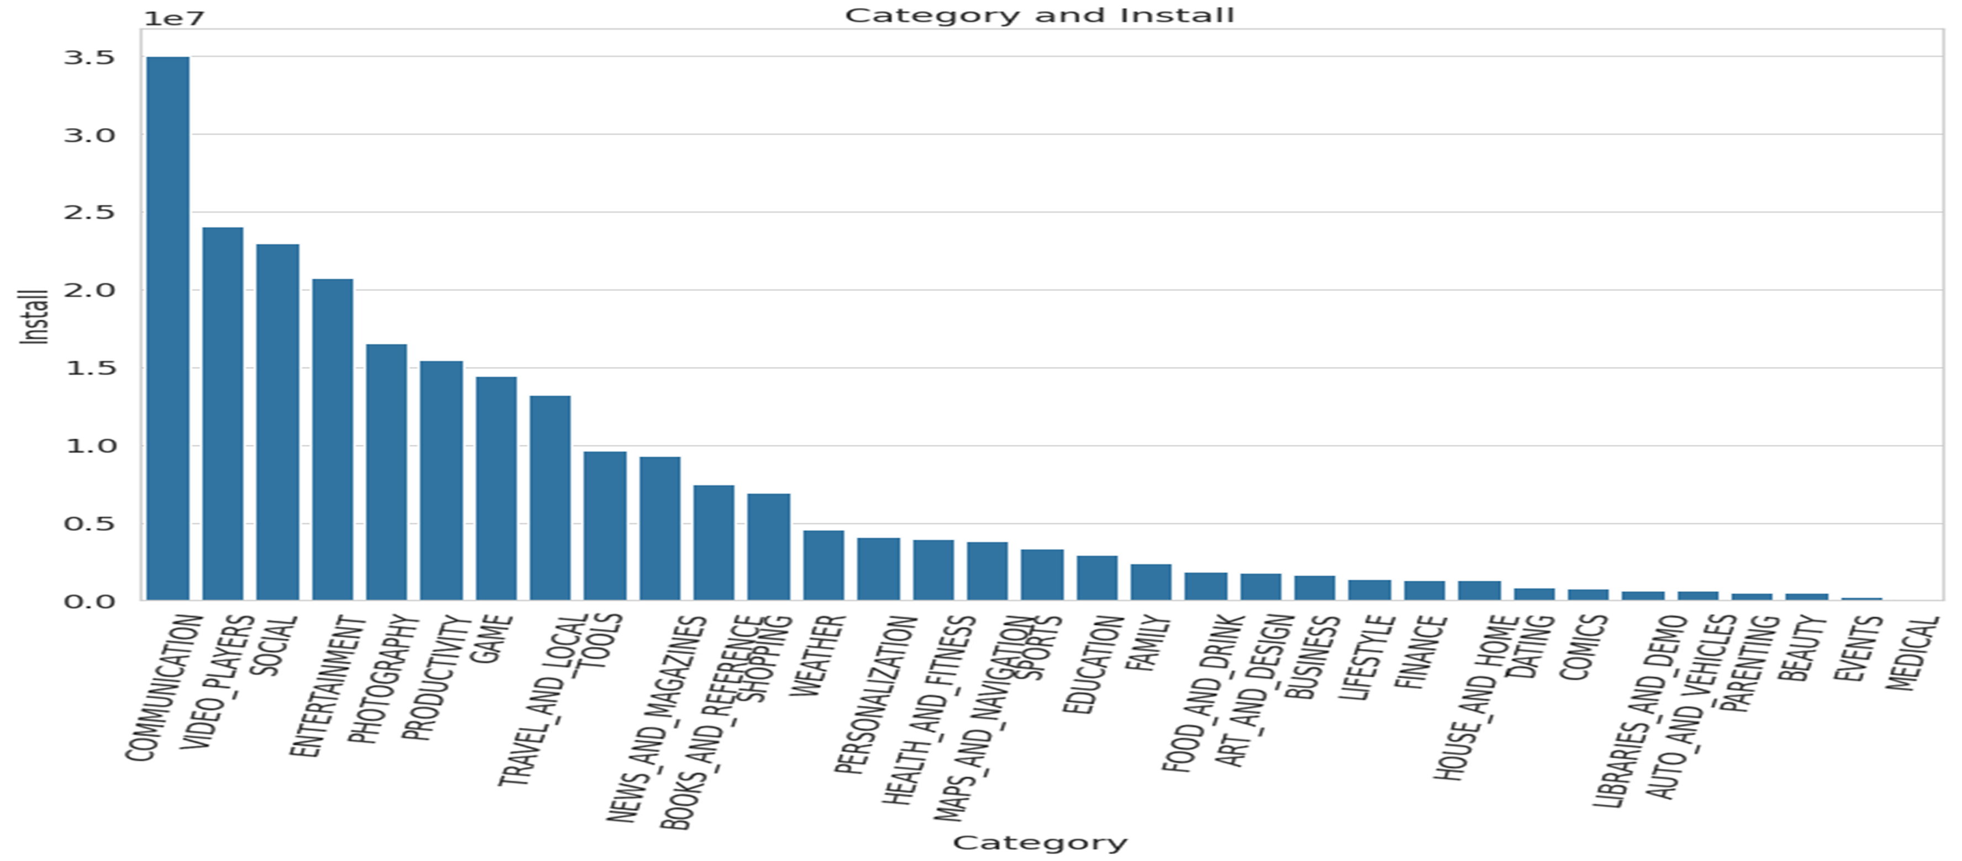
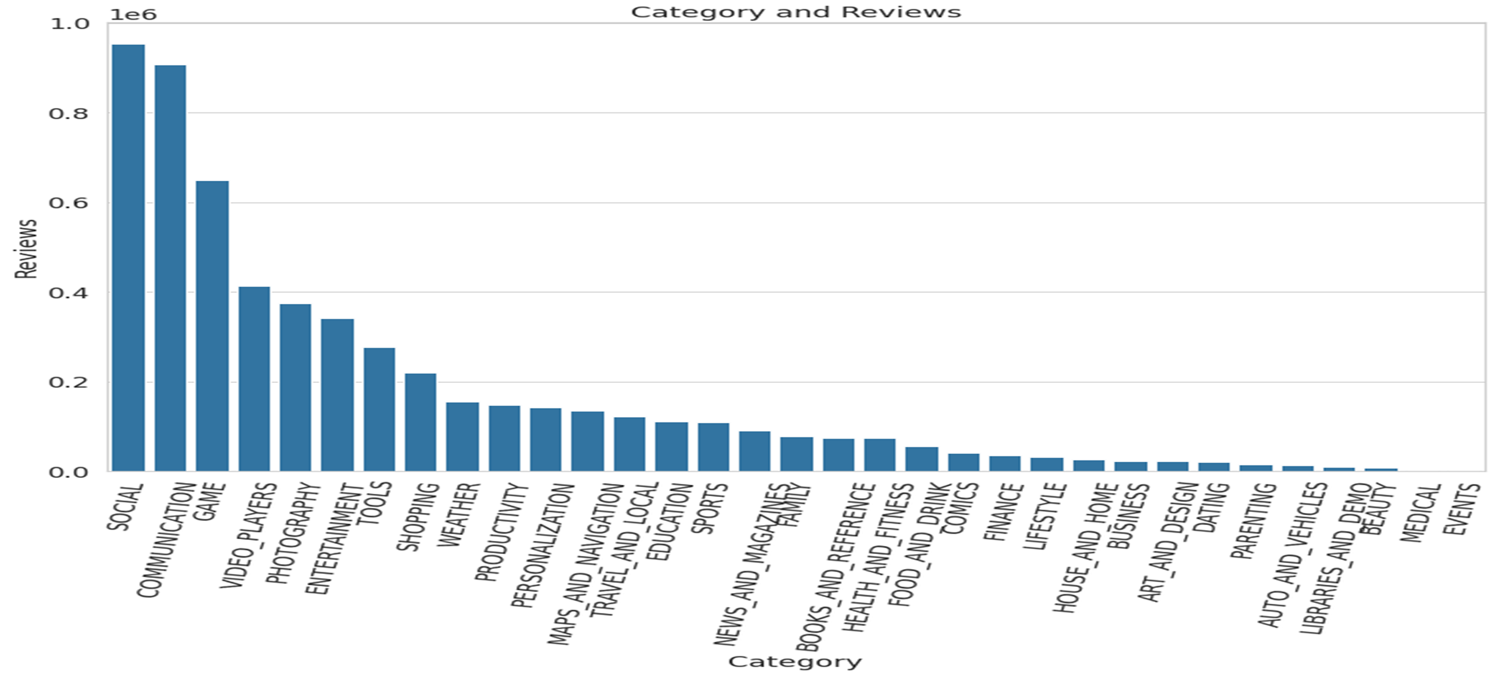
Category and Installs
Category and Reviews
Communication have the largest installations, closely followed by Video_players.
More success would be found if investment is made in communication apps instead of gaming apps, due to the higher probability of being installed.
Major development work is performed in Social, Communication and Game apps, as customers are constantly interacting with the developers expressing their appreciation and complaints.
Facebook, WhatsApp and Instagram are top reviewed applications also because they are top installed applications

Slide 6
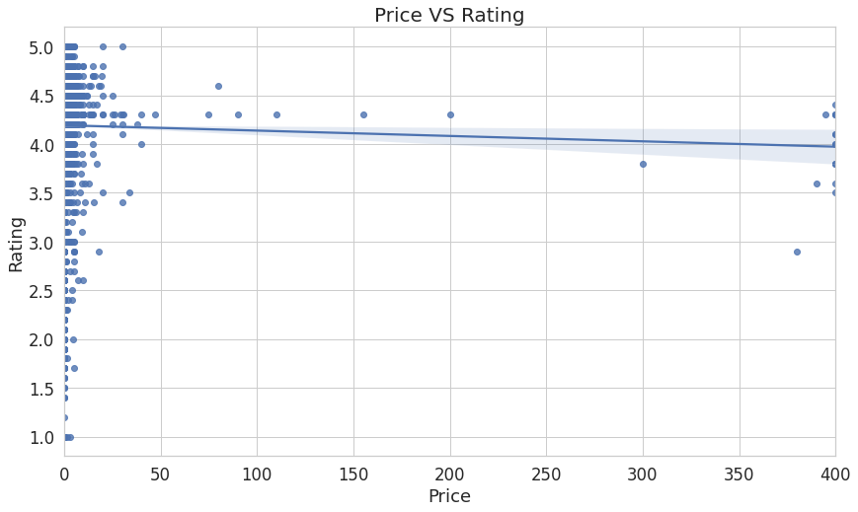
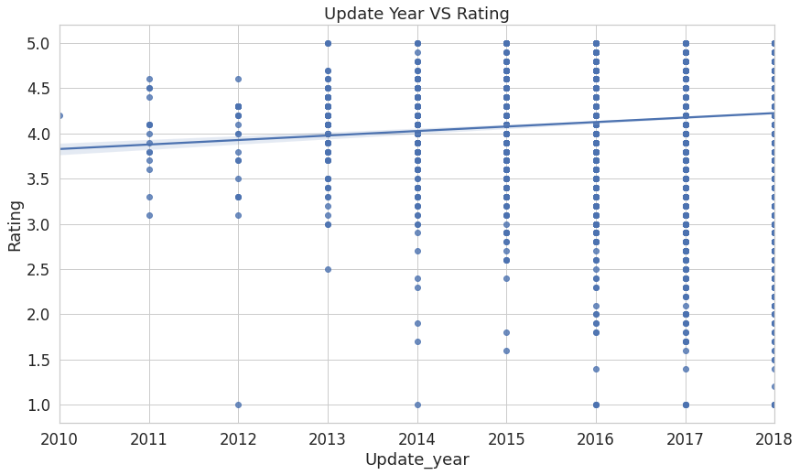
Price and Update Year vs Rating
Price and Rating
As the price increases, ratings received seems to decrease even below the average rating in the appstore
Apps either has a price lower than 100, or price greater than 300
Update Year and Rating:
As the app gets more recent updates chances
of getting a higher rating increases
Majority of the App are kept updated with 70% of apps updated in 2018

Slide 7
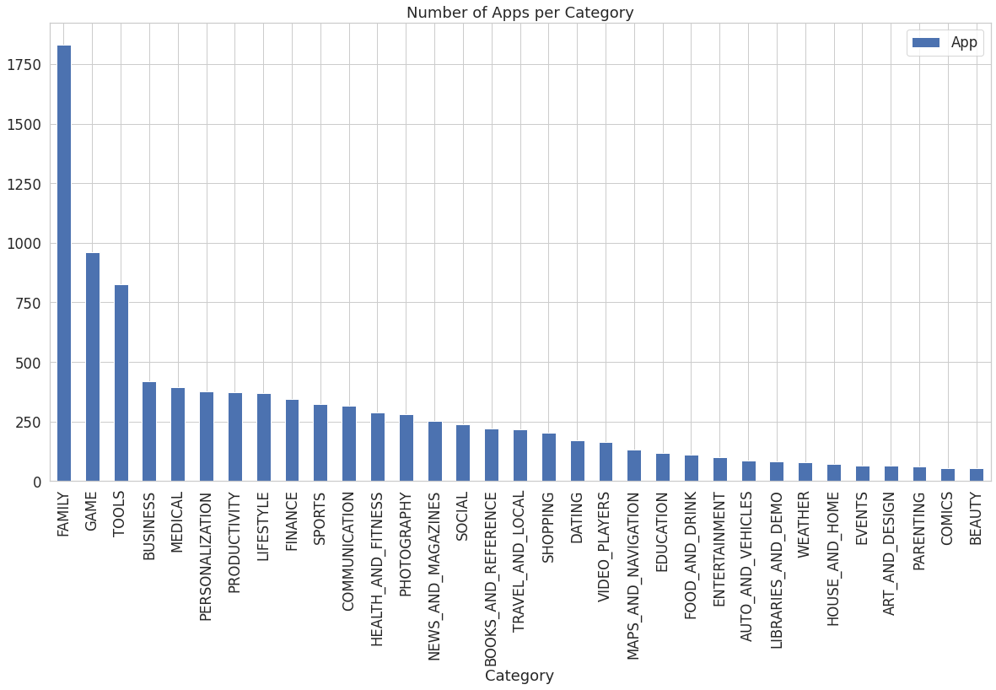
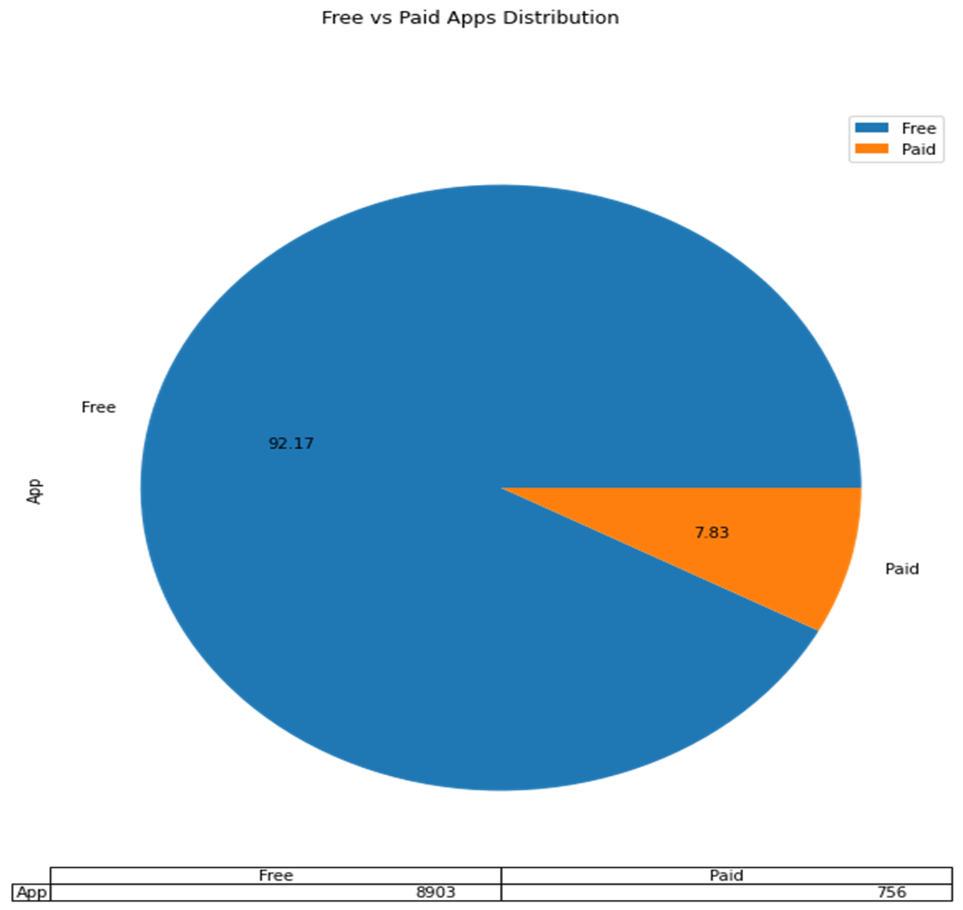
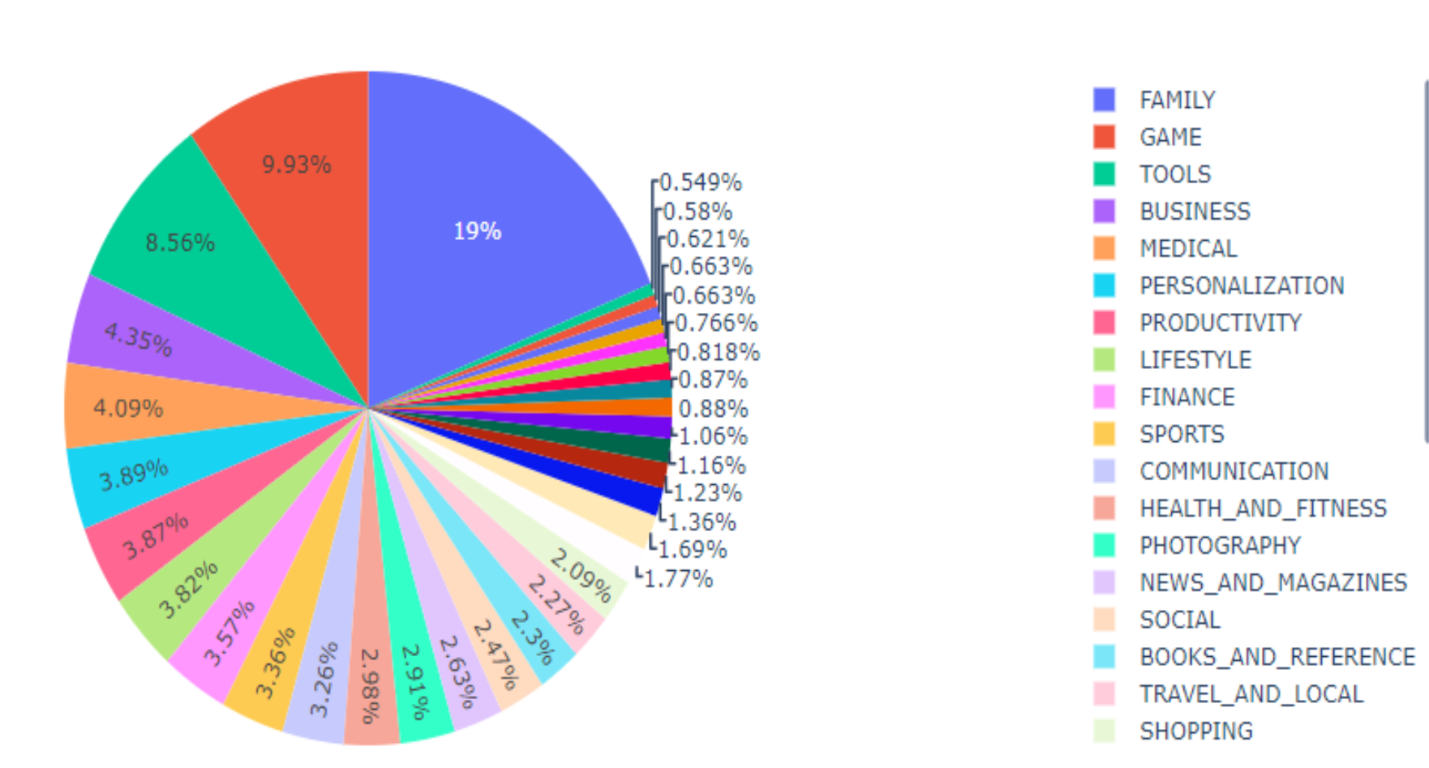
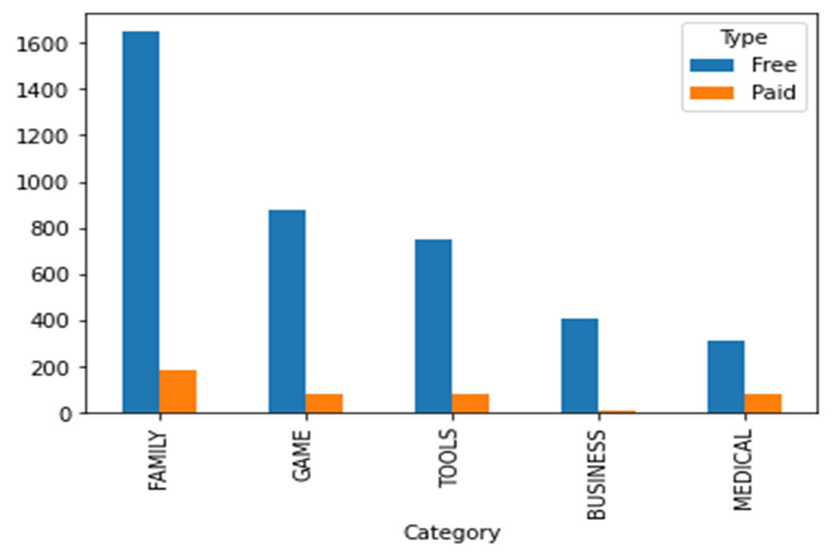
Apps per Category
Type- Free or Paid Analysis

Slide 8
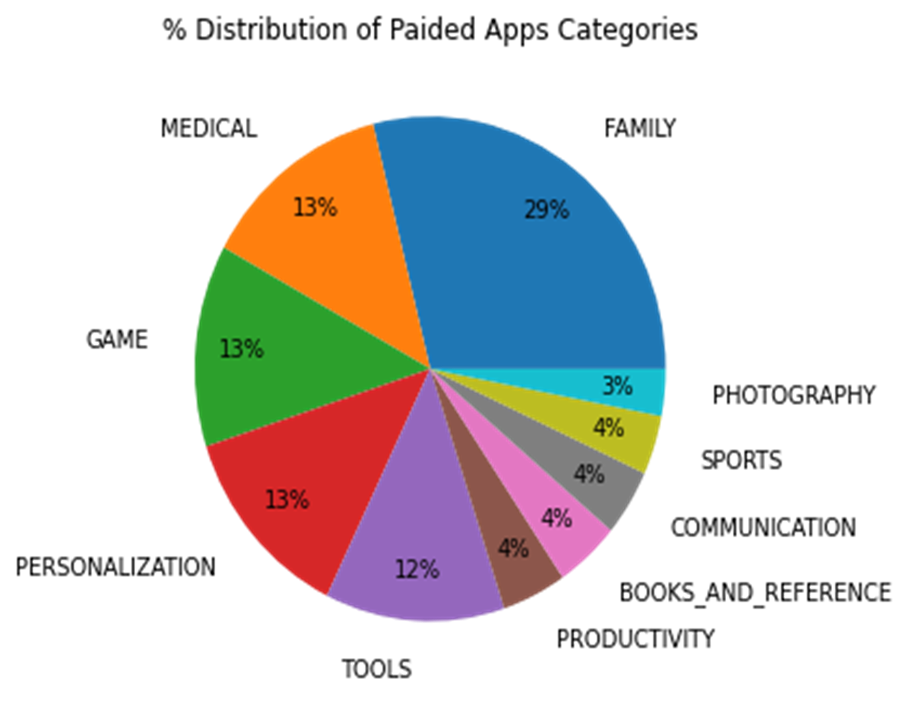
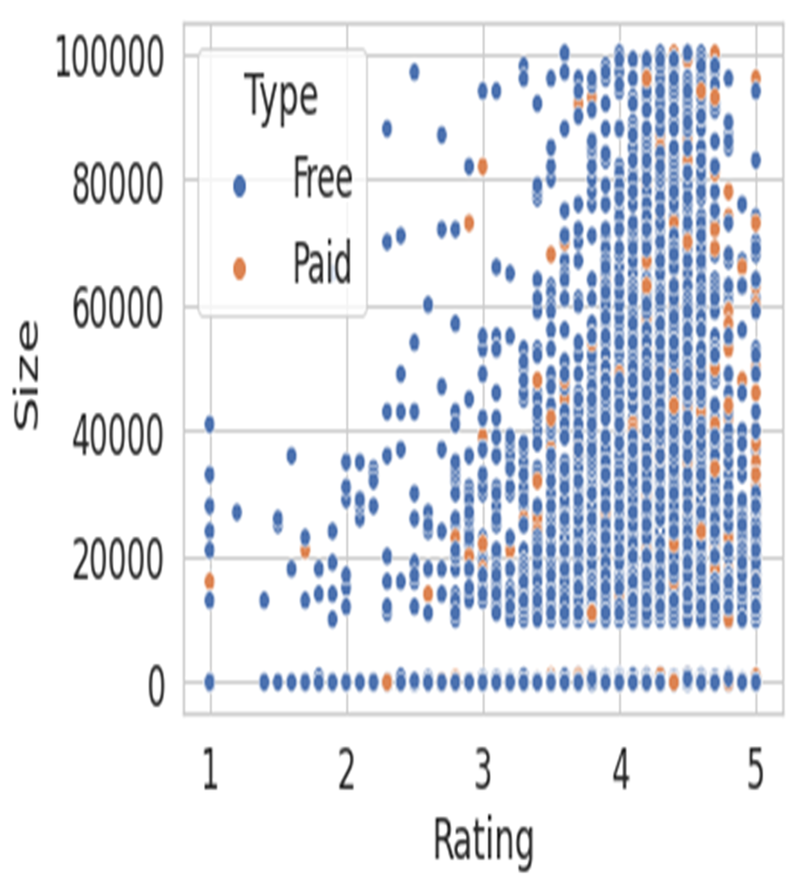
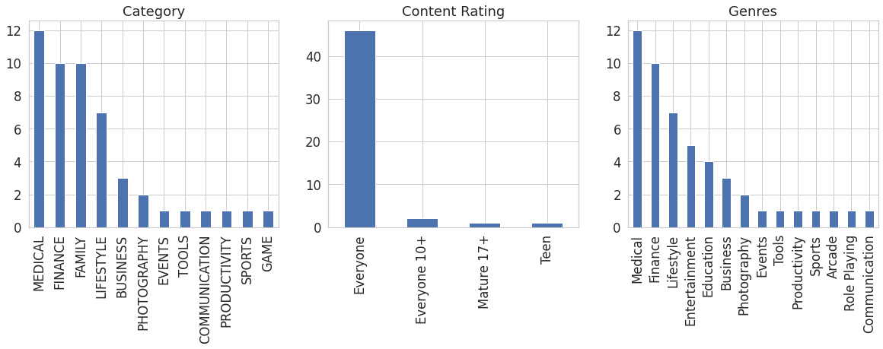
Analysis on Paid Apps
Paid apps have average high ratings.
Top 10 most expensive apps on playstore

Slide 9
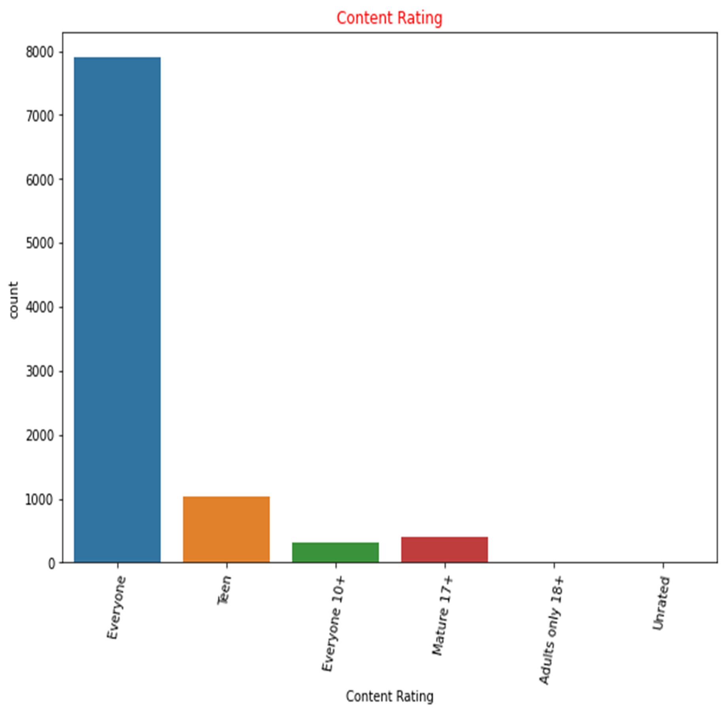
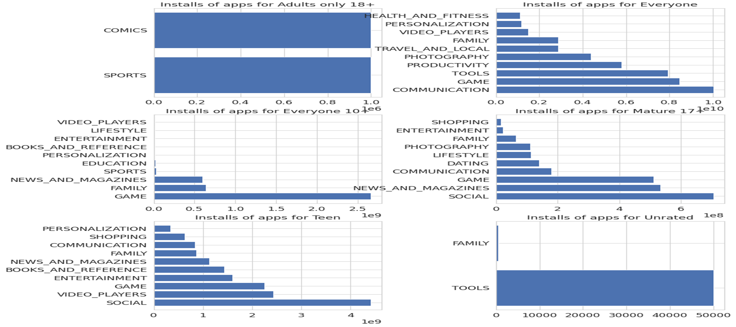
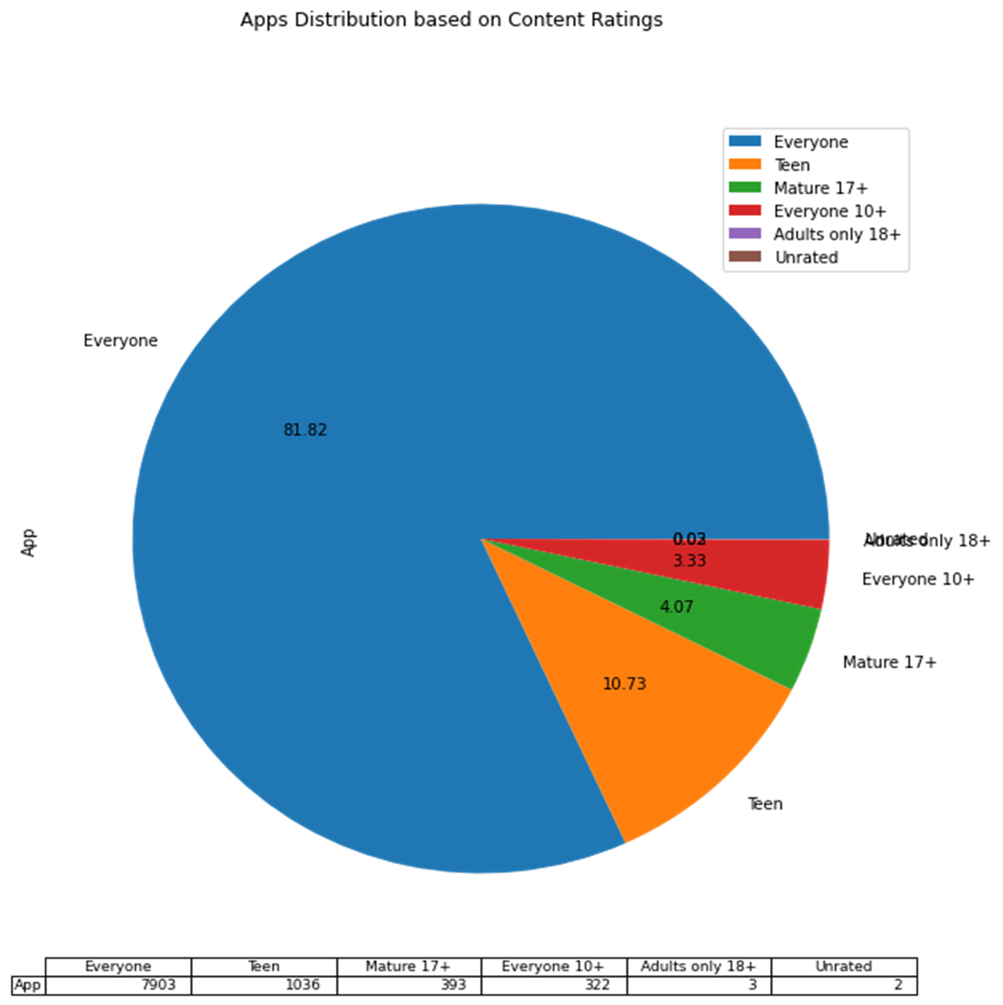
Apps Distribution based on Content Ratings
80% of Apps are used by everyone and only
10% of Apps are used by Teens
For example, teens absolutely love social networking apps and 10 year olds love games.
The mature 17+ users tend to use a lot of social network apps, which is closely followed by a considerable number of News and magazines apps relative to the teens.

Slide 10
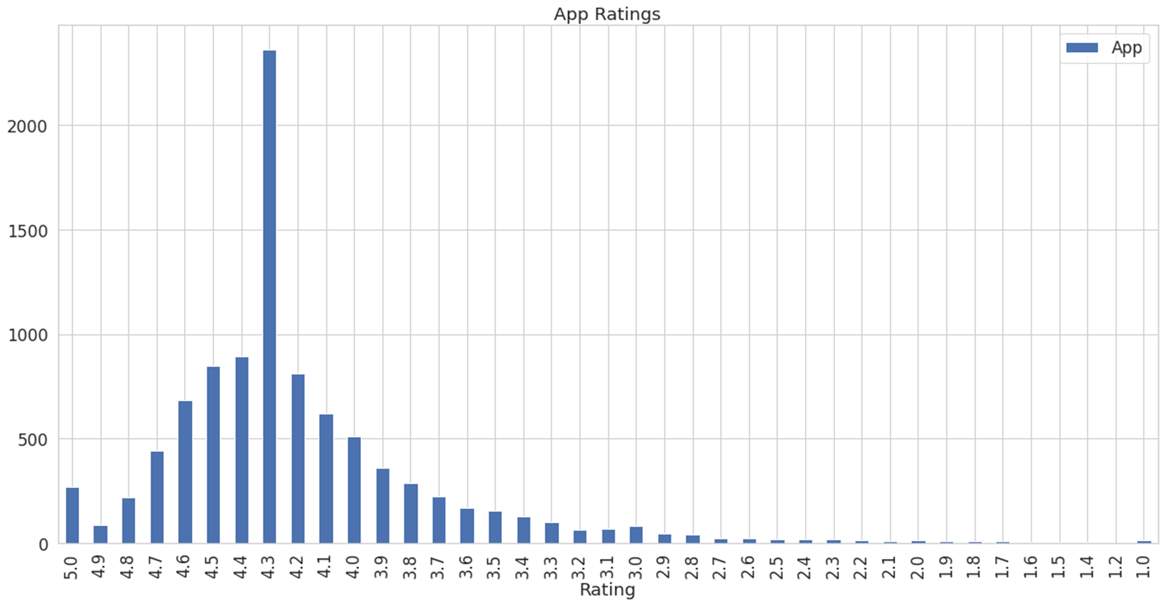
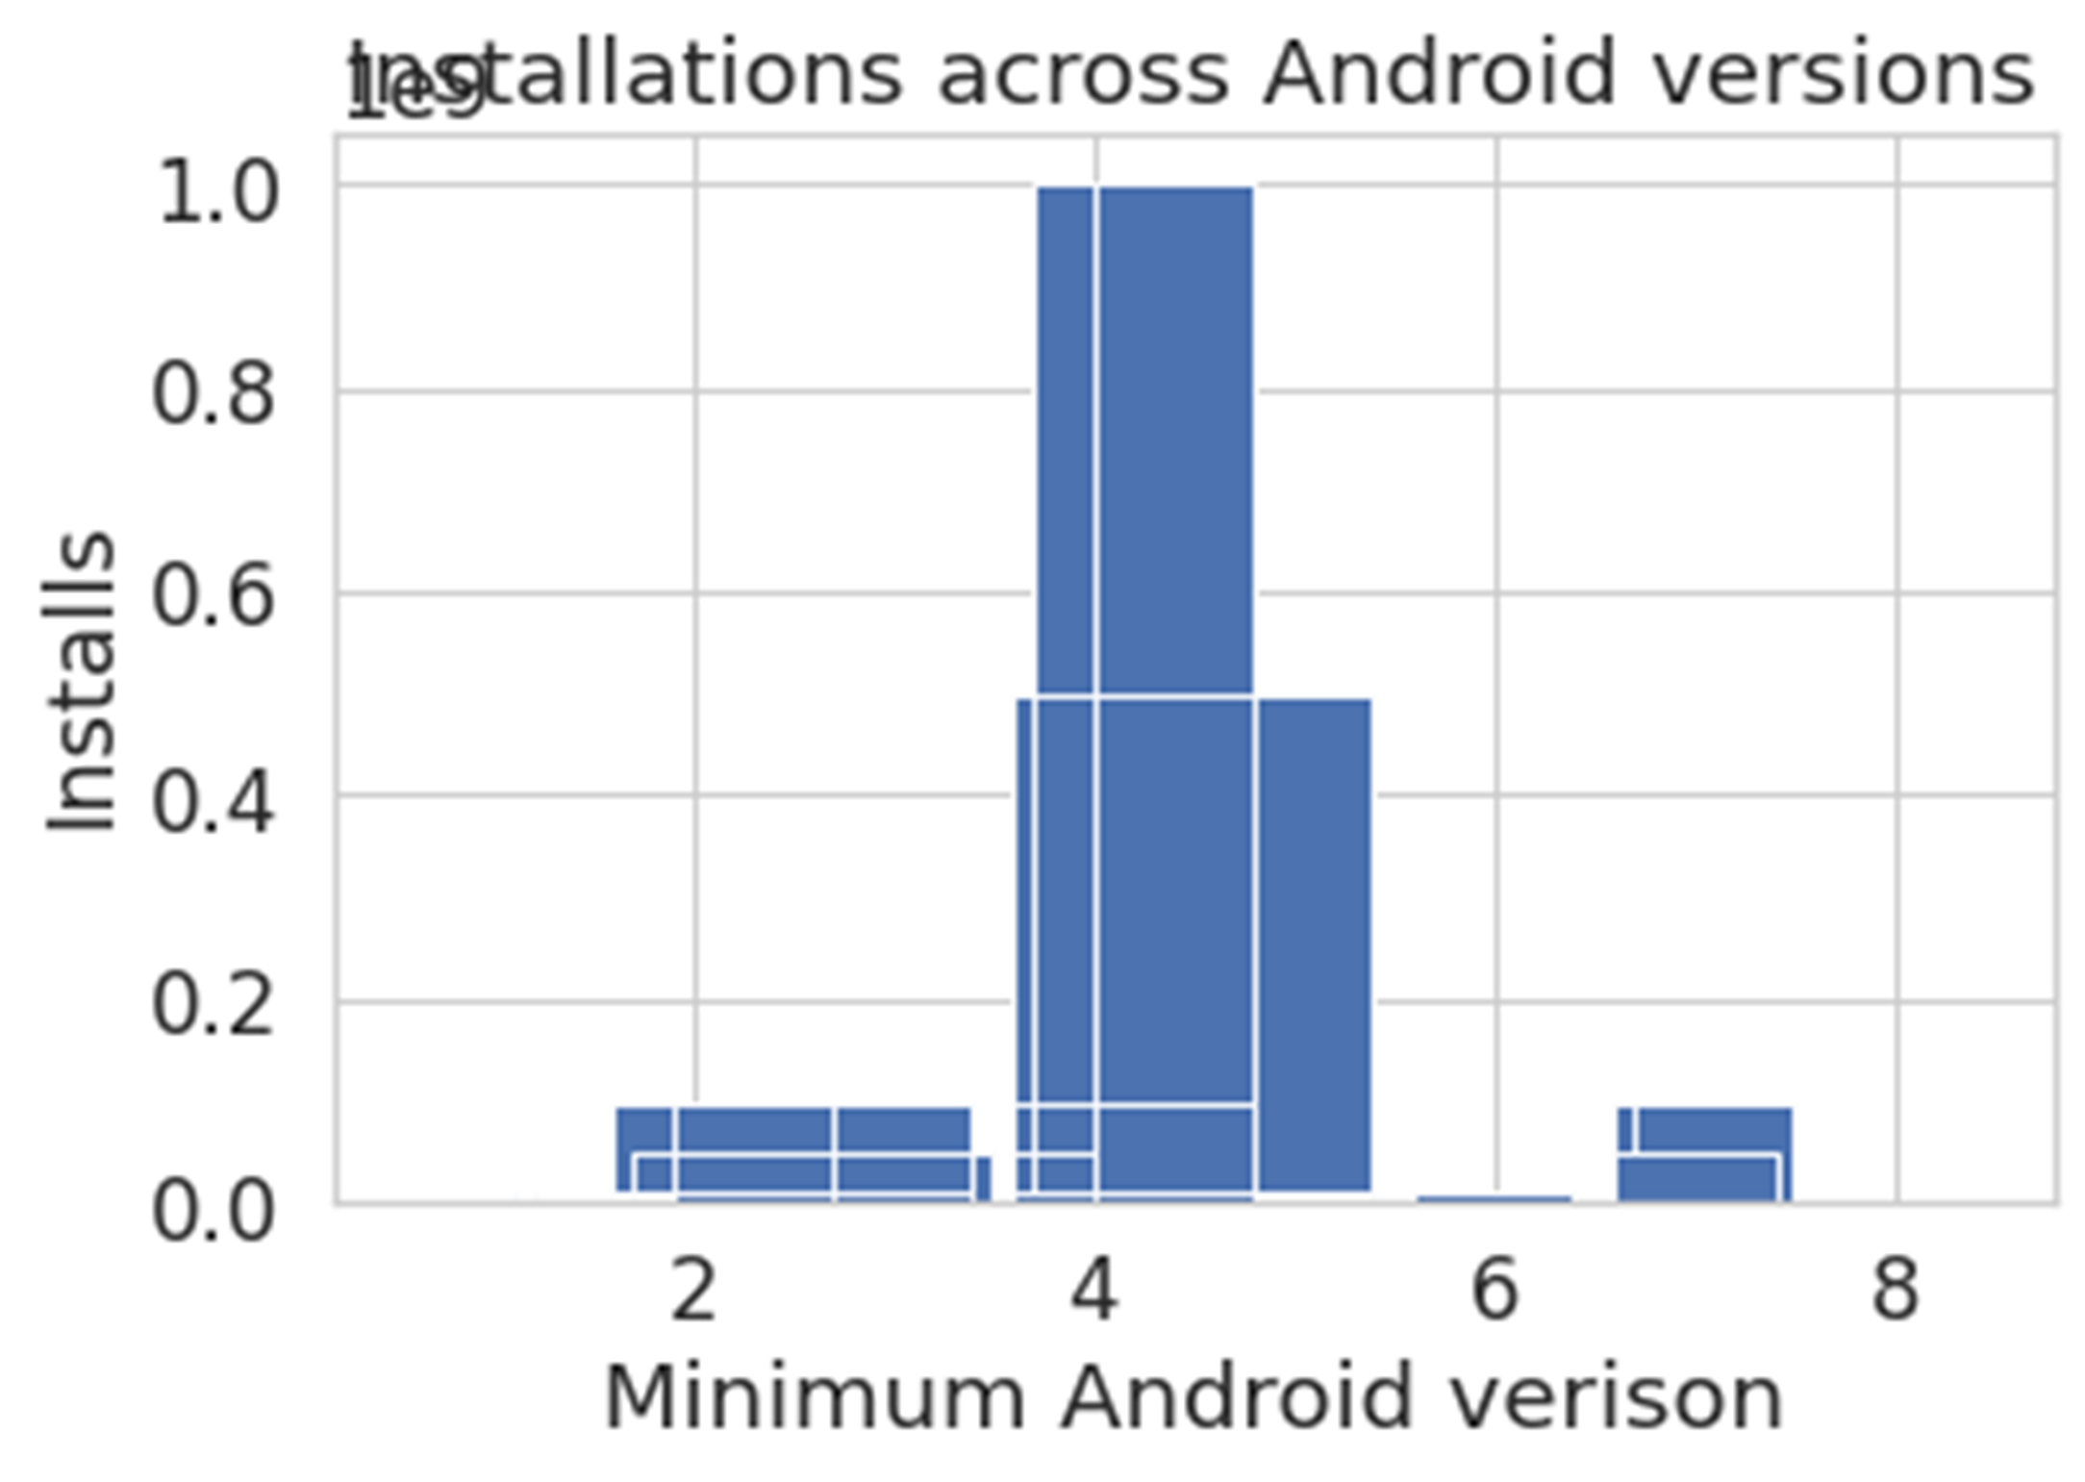
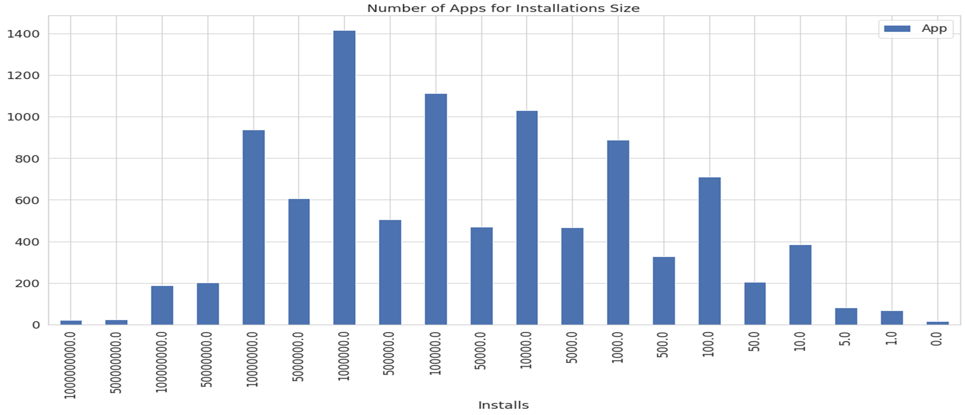
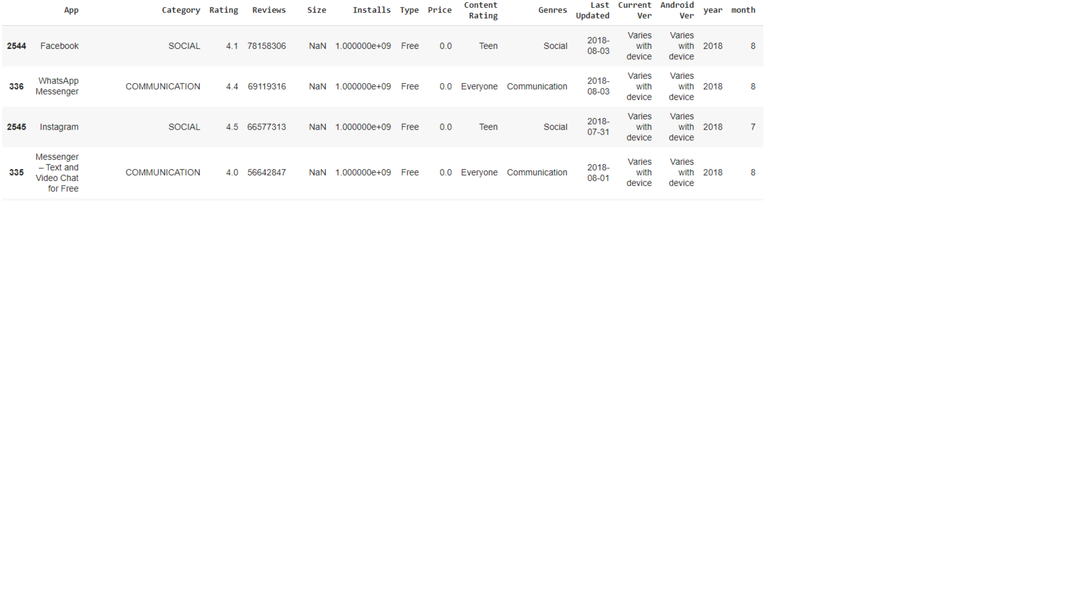
Ratings - App Counts
Android Version
App ratings per category are distributed between 4.0 and 4.5
In order to reach maximum number of smart phone users, a developer must make the application compatible with an android version of 4 and above.
Installs
There are 20 applications with 1+ billion installations and Top 2 apps are Facebook and Whatsapp
Popular apps (apps having more than 100M installs) received more reviews in total

Slide 11
Google Play Store Apps Analysis
Conclusion
A data-driven business venture could launch the app in the market of more competitors to get a better hold of the market relying on key feature and making further development.
Any start-up or company intend to develop a new mobile app needs to make certain their App fulfill a market need
This data analysis on the App store can help most of start-ups and mobile development companies to take business decisions to proceed or alter their plans from earlier stages, save money and reduce risks and increase customer satisfaction.

Slide 12
Thank you!
Shiji Shajahan
DATA SCIENCE

